Slide 1
ESQC 2024
Mathematical Methods Lecture 3
By Simen Kvaal

Slide 2

Where to find the material
SCAN ME
Alternative 1:
www.esqc.org, go to“lectures”
Find links there
Alternative 2:
Scan QR code
simenkva.github.io/esqc_material

Slide 3
Infinite Dimensions and Functional Analysis
Required for the formulation of physical laws

Slide 4
Functional analysis
The study of (mostly) infinite dimensional vector spaces
Hilbert, Banach (and more)
Function spaces
Linear transformations
In infinite dimensions strange things happen!
Applications:
Quantum mechanics
Partial differential equations
Optimization and control theory

Slide 5

Examples of infinite dimensions
The space of cake recipe ingredients list (from yesterday)
The space of all polynomials, unlimited degree
A space of sequences
The space of square integrable functions
Approximations of functions
For infinite basis expansions
Quantum mechanics!

Slide 6
How to think about something like
A function over ℝ – infinite number of values!
We can imagine an increasingly long finite vector of samples
In quant chem: a finite basis set of functions

Slide 7
What distinguishes the examples?
Consider the question:
Which functions are close to each other?
Use for different notions of ”closeness”
Extremely valuable!

Slide 8
Hilbert and Banach spaces
The spaces of partial differential equations

Slide 9

Now it is getting a little more abstract

Slide 10
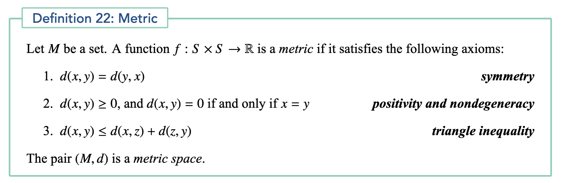
A metric embodies concept of distance

Slide 11
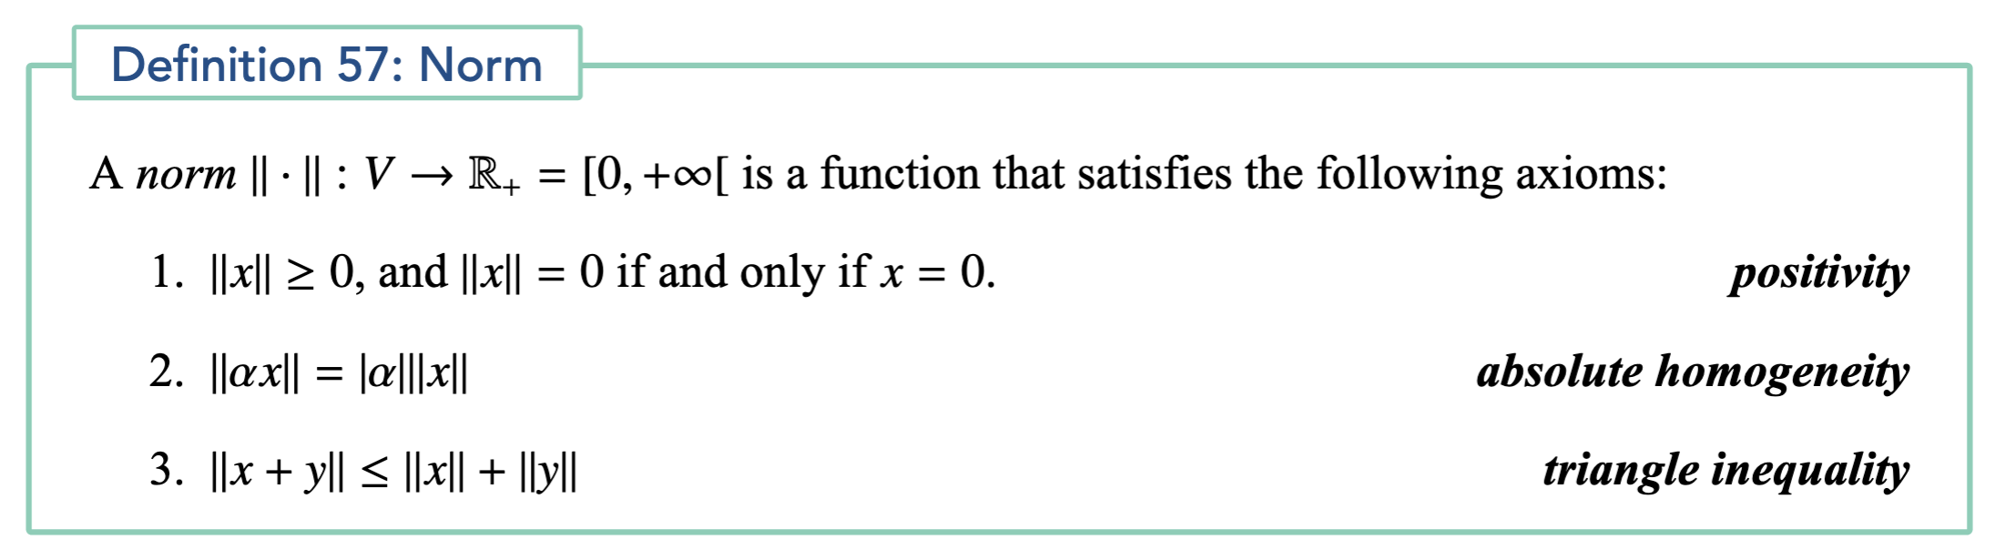
Norms embody concept of length
Norms define metrics

Slide 12
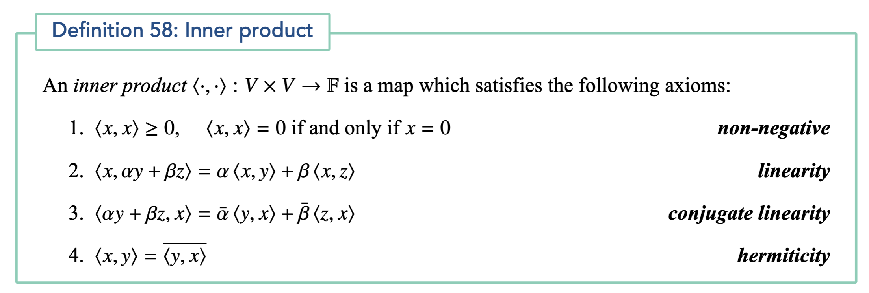
Inner products give concept of angles
Inner products give metrics, too

Slide 13


Two metrics in the plane (from norms)
Euclidean metric
“as the crow flies”
Manhattan metric
“as the taxi drives”

Slide 14
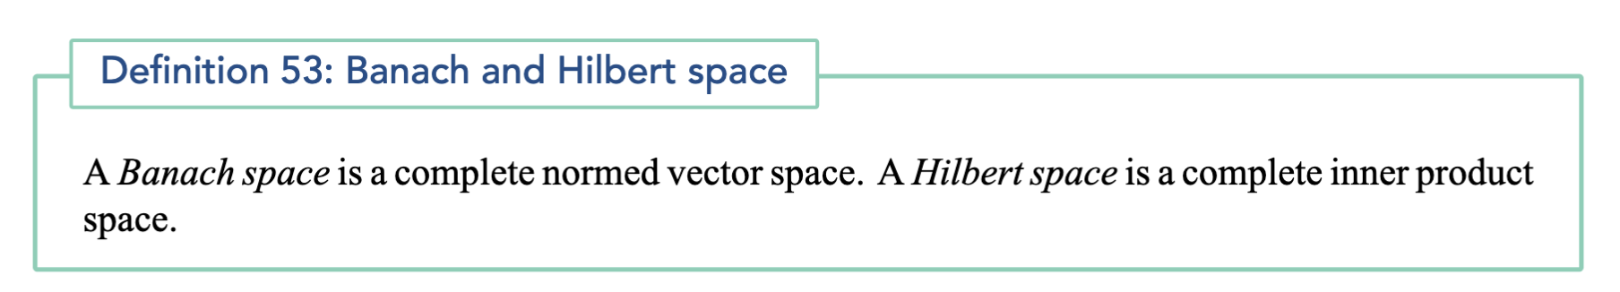
In all cases, metric spaces
The spaces of quantum mechanics, DFT, coupled-cluster theory ...
Infinite dimensional (separable) Hilbert space: infinite orthonormal basis

Slide 15
What can we do with a Banach space?
From norm to open sets
“A topology”
From open sets to convergence of sequences, completeness
From completeness to continuity of functions
Differentiability of functions
The metric/norm is the foundation for calculus, vector calculus, calculus of variations ...

Slide 16
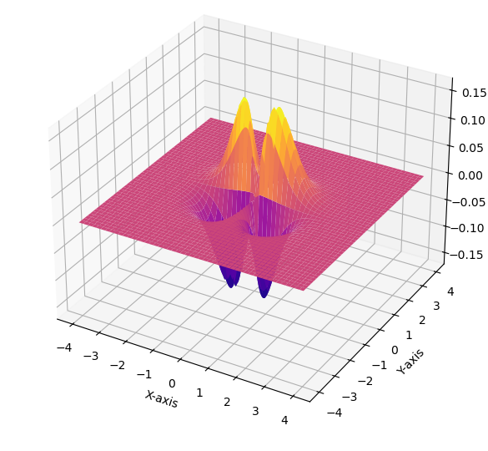
Spaces of functions
Here is an example function
Boxes in n dimensions
Intervals are typical

Slide 17
L^{p} spaces
For 1 ≤ p < ∞
This is a Banach space:

Slide 18
A notebook example
How different norms measure closeness of functions.
This shows us that different norms can be useful

Slide 19
More examples
Banach space:
Example:
Hilbert space:
Example:

Slide 20
𝓁_{p} spaces
Discrete versions of L^{p}
A Hilbert space:

Slide 21
The archetypal (separable) Hilbert space
Recall that in finite dimensions, 𝔽^{n} was the archetypal Hilbert space
In infinite dimensions:
All Hilbert spaces are isomorphic to this space, when an (infinite) orthonormal basis is chosen

Slide 22
Linear transformations over Banach space
In finite dimensions: all operators associated with matrices
No longer true!
Bounded vs. unbounded transformations
Key feature:
Bounded transformations are continuous
Unbounded transformations are discontinuous
Unbounded transformations usually not defined for all vectors

Slide 23
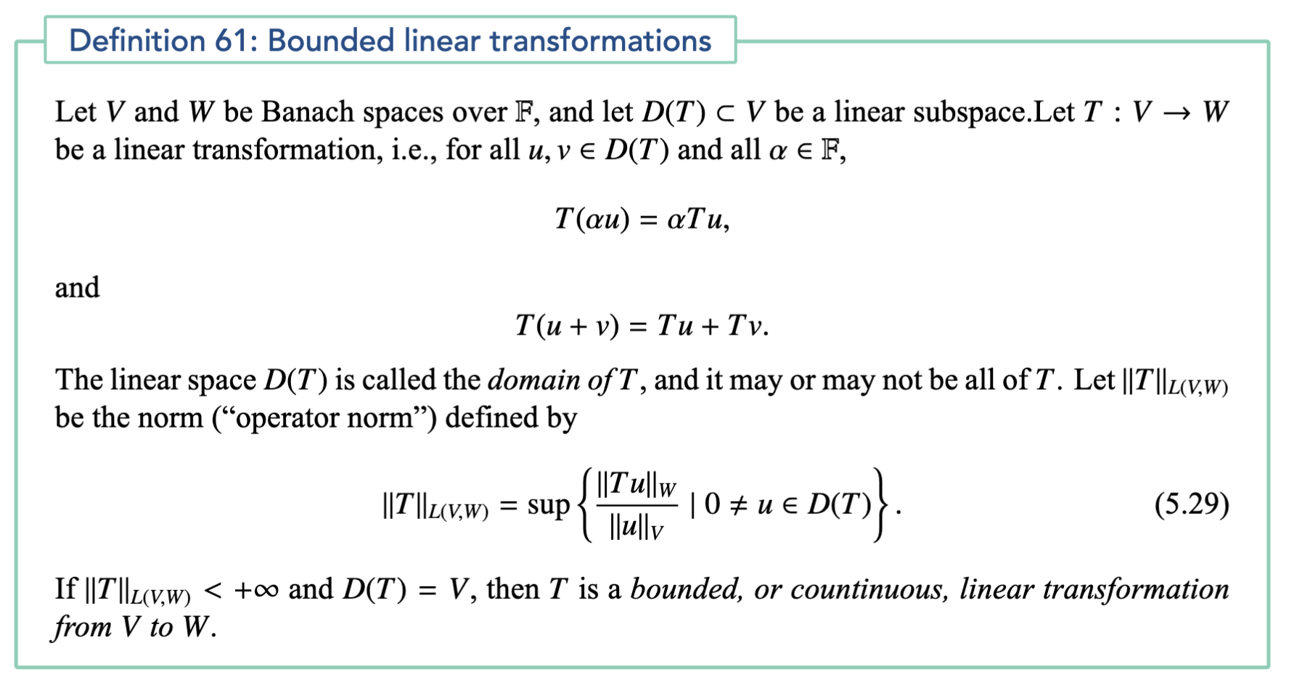

Slide 24
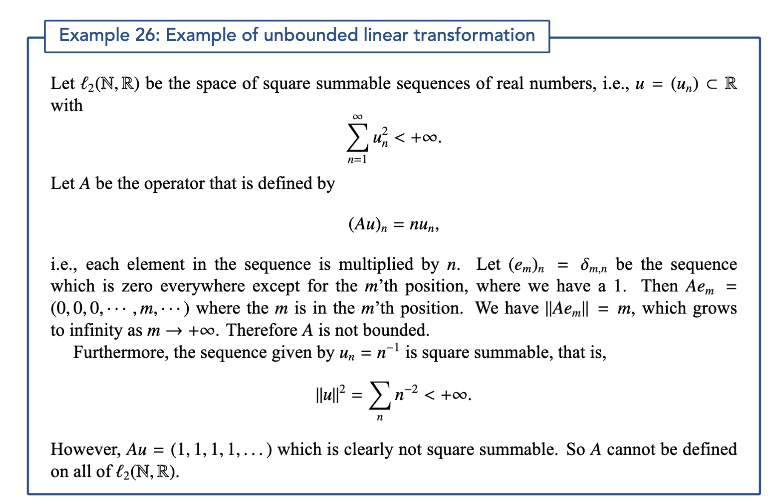

Slide 25
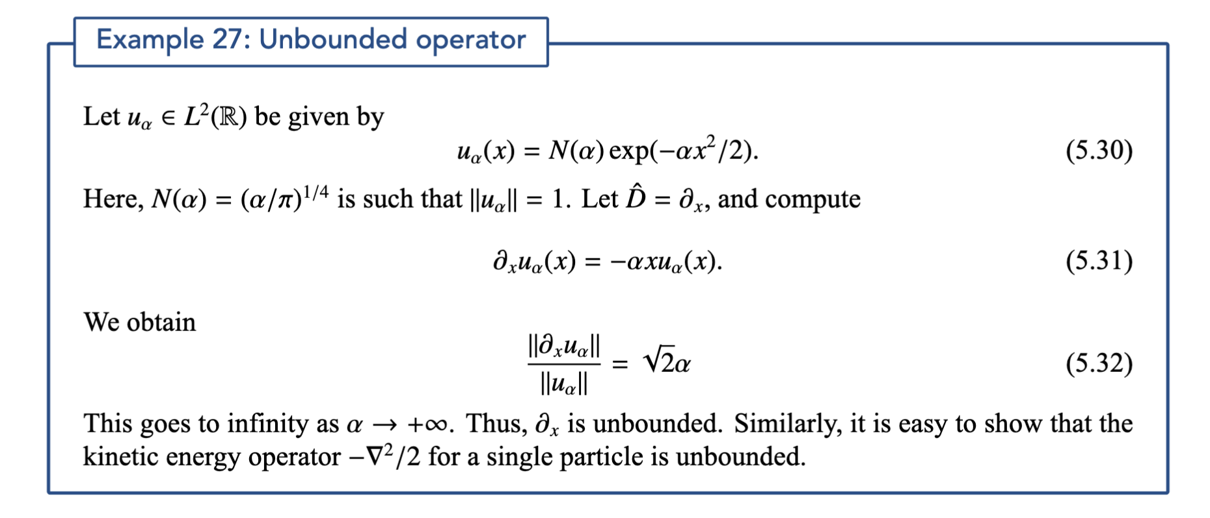

Slide 26
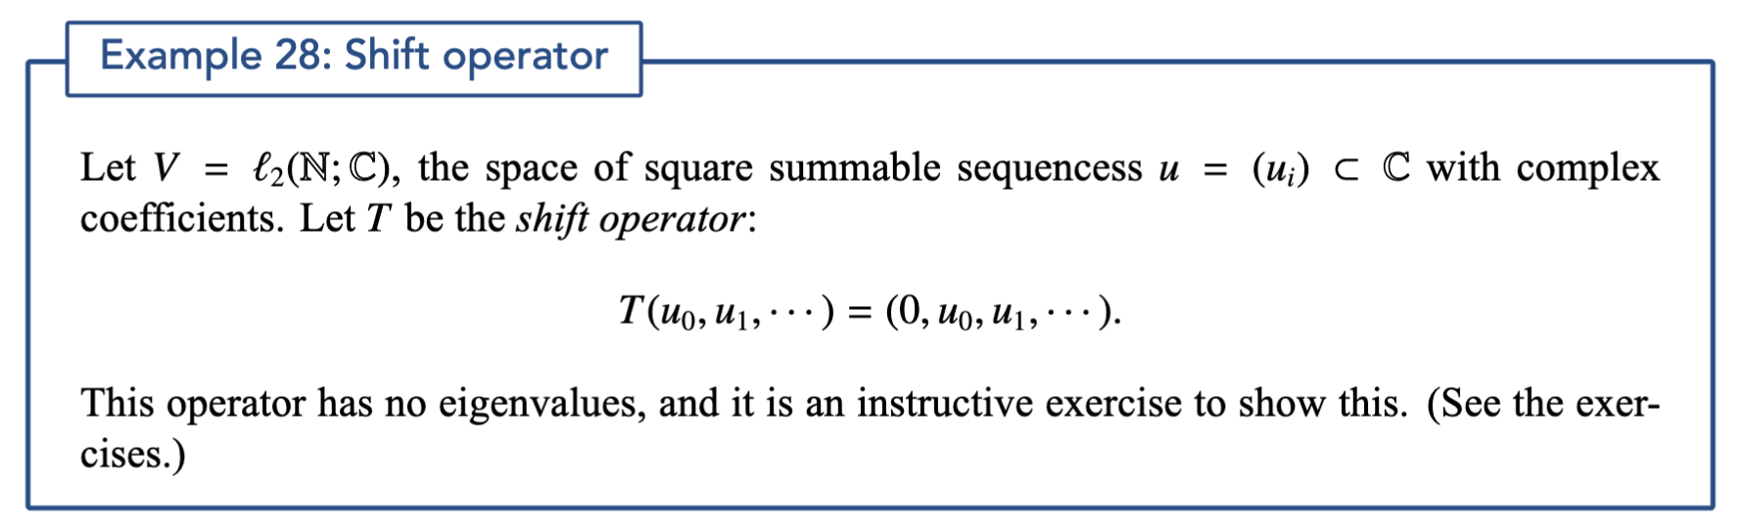
Eigenvalues may not exist
In finite dimensions: Any matrix has an eigenvalue!
(We did not mention this earlier, but true!)

Slide 27
Yesterday ...
There exists an orthonormal basis such that A is just stretching of axes

Slide 28
Spectrum “=“ eigenvalues
In finite dimensions spectrum is a discrete set:
In infinite dimensions, possible with continua:
Not eigenvalues, because
no eigenvectors!

Slide 29
Rough version of spectral theorem
In finite dimensions:
Infinite dimensions, using bra-ket notation ...

Slide 30
Sobolev spaces
Useful for analysis of partial differential equations

Slide 31
Kinetic energy example
Consider a single electron wavefunction:
Kinetic energy:
All allowed states of electrons must have finite kinetic energy

Slide 32
Sobolev spaces
Function spaces for partial differential equations
Previously we had for example
Can be useful to also require something on derivatives!
A simple Sobolev norm:

Slide 33
Example
Smaller and smaller oscillations
We consider a function sequence
Jupyter notebook: We compute L² norms and W¹² norms

Slide 34
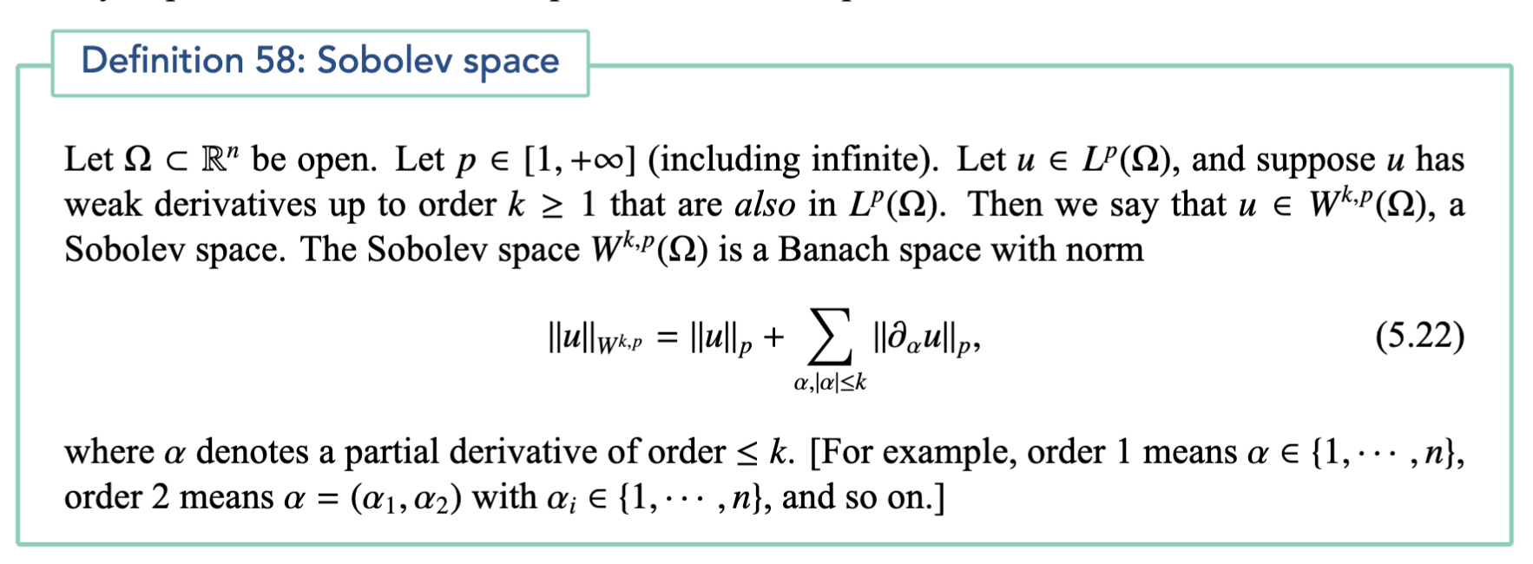
General definition

Slide 35
Rayleigh-Ritz variational principle
Recall unbounded operator only defined on domain
We need finite kinetic energy
Domain is a Sobolev spce!
Errors are best measured in Sobolev norms.

Slide 36
The axioms of quantum mechanics
Using what we have seen so far

Slide 37
Classical configuration space
Electron spin associated with 2 copies of space!
A single electron can be at any
N electrons can be configured as

Slide 38
Axiom 1: State space
The states of a quantum system are (up to a global phase factor) normalized elements in a separable Hilbert space
For a single electron:
A more general L2 space than previously seen ...

Slide 39
Axiom 2: Observables
Observables are represented by self-adjoint operators over
Examples:
All these are unbounded operators ...

Slide 40
Axiom 3: Outcomes of measurements
The outcomes of measurements of an observable are the spectral points of the observable
Immediately after the measurement, the wavefunction is projected onto the corresponding eigenfunction (wavefunction collapse)

Slide 41
Axiom 4: Born interpretation
Recall the spectral decomposition:
The probability of obtaining an outcome in, e.g.,

Slide 42
Axiom 5: Time evolution
Between measurements, the state evolves according to the time-dependent Schrödinger equation:
This is not rigorous!
Stone’s Theorem fixes this: Propagator is always well-defined:
TDSE satisfied in a generalized sense

Slide 43
N-electron theory

Slide 44
Example: Euclidean and Manhattan revisited
All points within a distance 𝜀 from the origin.
Boundary not included.

Slide 45
Open and closed in Euclidean space
1. Open
2. Not open (closed)
3. Neither!
A set is closed if the complement is open:

Slide 46
End of lecture 3
Next time, differentiable functions

